Slide 1
Two-Qubit CAVITY COUPLING
Effective Hamiltonian

Slide 2



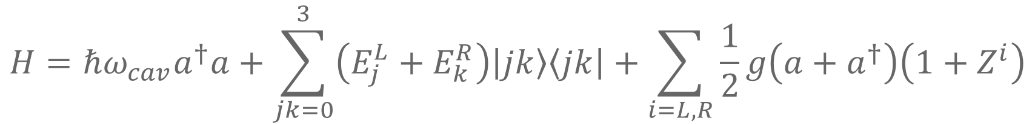













Hamiltonian without Noise
$$H=ℏω_{cav}a^{†}a+\sum_{jk=0}^{3}{\left(E_{j}^{L}+E_{k}^{R}\right)\left|jk\right\rangle \left\langle jk\right|}+\sum_{i=L,R}{\frac{1}{2}g\left(a+a^{†}\right)\left(1+Z^{i}\right)}$$
$$\left|n_{0}+1\right\rangle$$
$${\left|3\right\rangle }_{L}$$
$${\left|3\right\rangle }_{R}$$
$${\left|2\right\rangle }_{L}$$
$${\left|2\right\rangle }_{R}$$
$$\left|n_{0}\right\rangle$$
$$δ_{c}$$
$${\left|1\right\rangle }_{L}$$
$$δ_{f}$$
$${\left|1\right\rangle }_{R}$$
$$ω_{f}$$
$$ω_{c}$$
$$ω_{cav}$$
$${\left|0\right\rangle }_{L}$$
$$\left|n_{0}−1\right\rangle$$
$${\left|0\right\rangle }_{R}$$
Left Qubit
Cavity
Right Qubit

Slide 3
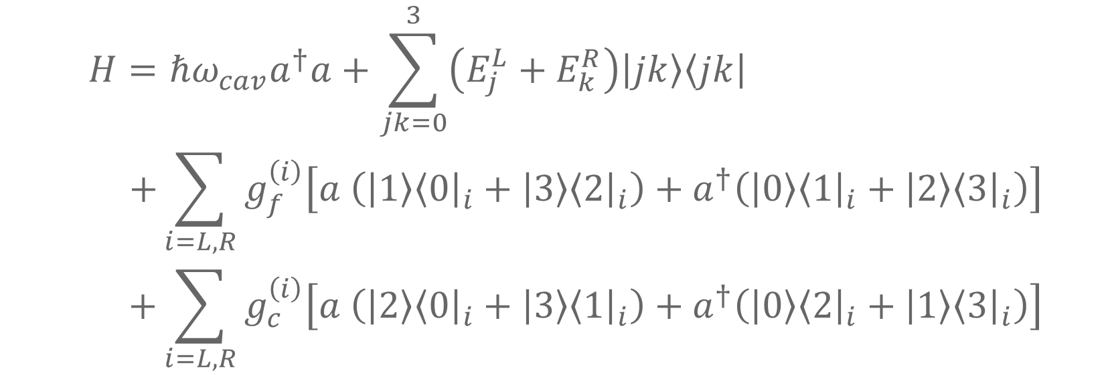
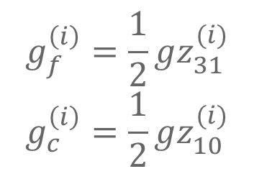
RWA
$$H=ℏω_{cav}a^{†}a+\sum_{jk=0}^{3}{\left(E_{j}^{L}+E_{k}^{R}\right)\left|jk\right\rangle \left\langle jk\right|} \\ +\sum_{i=L,R}{g_{f}^{\left(i\right)}\left[a \left(\left|1\right\rangle {\left\langle 0\right|}_{i}+\left|3\right\rangle {\left\langle 2\right|}_{i}\right)+a^{†}\left(\left|0\right\rangle {\left\langle 1\right|}_{i}+\left|2\right\rangle {\left\langle 3\right|}_{i}\right)\right]} \\ +\sum_{i=L,R}{g_{c}^{\left(i\right)}\left[a \left(\left|2\right\rangle {\left\langle 0\right|}_{i}+\left|3\right\rangle {\left\langle 1\right|}_{i}\right)+a^{†}\left(\left|0\right\rangle {\left\langle 2\right|}_{i}+\left|1\right\rangle {\left\langle 3\right|}_{i}\right)\right]}$$
Spin flip
Charge flip
$$g_{f}^{\left(i\right)}=\frac{1}{2}gz_{31}^{(i)}$$
$$g_{c}^{\left(i\right)}=\frac{1}{2}gz_{10}^{(i)}$$
Flip-flop qubit - cavity coupling
Charge qubit - cavity coupling

Slide 4
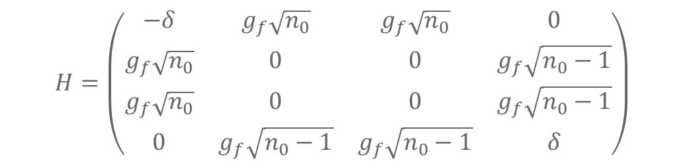

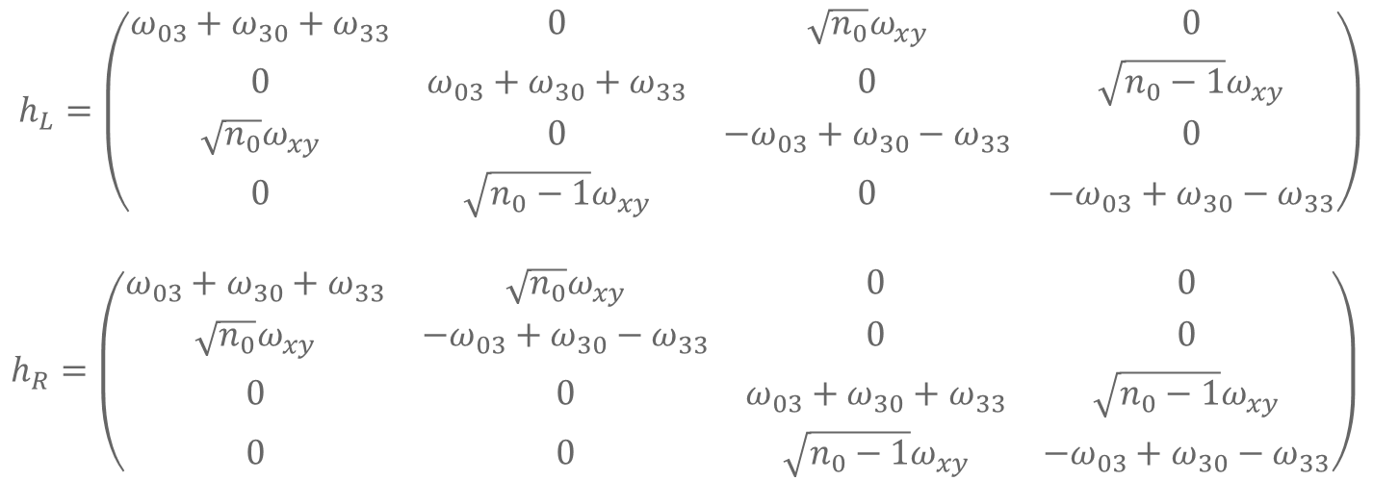
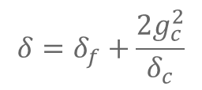
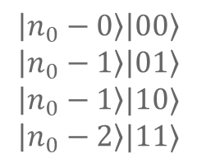
Total Hamiltonian (2nd Order SW)
$$H=\left(\begin{matrix}−δ & g_{f}\sqrt{n_{0}} & g_{f}\sqrt{n_{0}} & 0 \\ g_{f}\sqrt{n_{0}} & 0 & 0 & g_{f}\sqrt{n_{0}−1} \\ g_{f}\sqrt{n_{0}} & 0 & 0 & g_{f}\sqrt{n_{0}−1} \\ 0 & g_{f}\sqrt{n_{0}−1} & g_{f}\sqrt{n_{0}−1} & δ\end{matrix}\right)$$
$$\left|n_{0}−0\right\rangle \left|00\right\rangle \\ \left|n_{0}−1\right\rangle \left|01\right\rangle \\ \left|n_{0}−1\right\rangle |10⟩$$
$$\left|n_{0}−2\right\rangle |11⟩$$
$$δ=δ_{f}+\frac{2g_{c}^{2}}{δ_{c}}$$
$$ω_{xy}=\frac{g_{c}ω_{n}}{2δ_{c}}(z_{22}+z_{11})$$
$$h_{L}=\left(\begin{matrix}ω_{03}+ω_{30}+ω_{33} & 0 & \sqrt{n_{0}}ω_{xy} & 0 \\ 0 & ω_{03}+ω_{30}+ω_{33} & 0 & \sqrt{n_{0}−1}ω_{xy} \\ \sqrt{n_{0}}ω_{xy} & 0 & {−ω}_{03}+ω_{30}−ω_{33} & 0 \\ 0 & \sqrt{n_{0}−1}ω_{xy} & 0 & {−ω}_{03}+ω_{30}−ω_{33}\end{matrix}\right) \\ h_{R}=\left(\begin{matrix}ω_{03}+ω_{30}+ω_{33} & \sqrt{n_{0}}ω_{xy} & 0 & 0 \\ \sqrt{n_{0}}ω_{xy} & {−ω}_{03}+ω_{30}−ω_{33} & 0 & 0 \\ 0 & 0 & ω_{03}+ω_{30}+ω_{33} & \sqrt{n_{0}−1}ω_{xy} \\ 0 & 0 & \sqrt{n_{0}−1}ω_{xy} & −ω_{03}+ω_{30}−ω_{33}\end{matrix}\right)$$

Slide 5
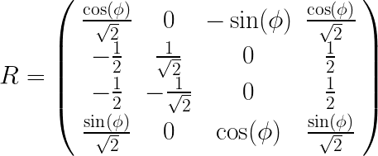
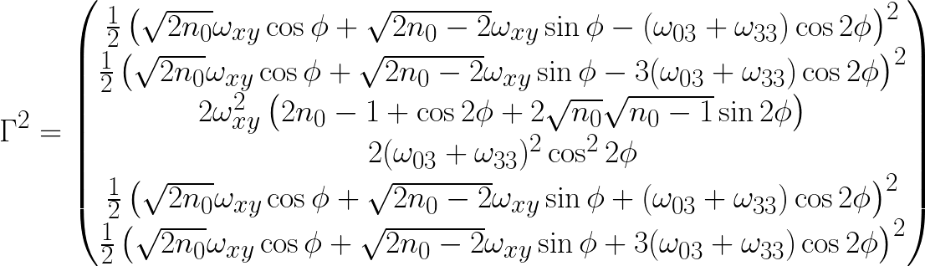









Case 1: $δ=0$, Resonance
$$P_{01}\left(t\right)=P_{eq}+\sum_{k}{2C_{k}\cos\left(ω_{k}t\right)e^{−J\left(t\right)Γ_{k}^{2}}}$$
$$P_{eq}=\frac{3}{8}$$
$$C=\frac{1}{16}\left(2,0,1,0,2,0\right)$$
$$ω=g_{f}\sqrt{4n_{0}−2}\left(1,1,2,0,1,1\right)$$
$$\sqrt{2n_{0}−1}$$
$$\sqrt{n_{0}−1}$$
$$φ$$
$$\sqrt{n_{0}}$$

Slide 6
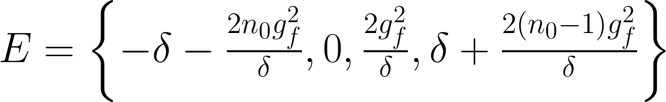
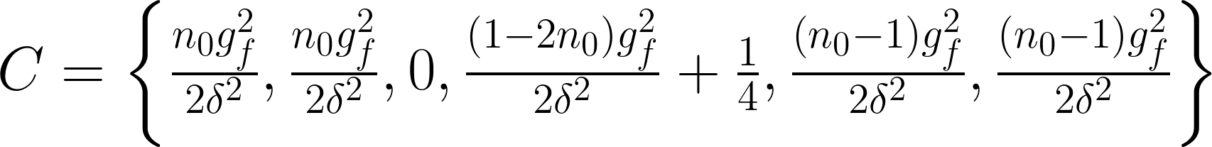
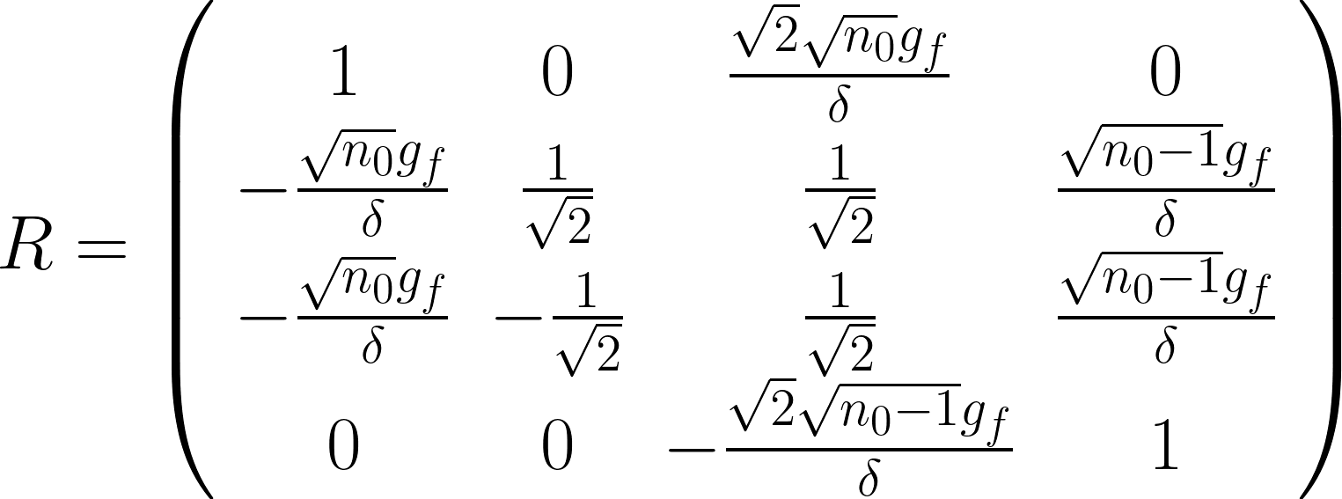



Case 3: $δ≫g_{f}$, Weak Coupling
$$P_{01}\left(t\right)=P_{eq}+\sum_{k}{2C_{k}\cos\left(ω_{k}t\right)e^{−J\left(t\right)Γ_{k}^{2}}}$$
$$P_{eq}=\frac{1}{2}−\frac{\left(2n_{0}−1\right)g_{f}^{2}}{δ^{2}}$$
$$Γ_{3}^{2}=\frac{8ω_{xy}^{2}g_{f}^{2}}{δ^{2}}$$

Slide 7

Case 2: $δ≪g_{f}$, Strong Coupling
$$P_{01}\left(t\right)=P_{eq}+\sum_{k}{2C_{k}\cos\left(ω_{k}t\right)e^{−J\left(t\right)Γ_{k}^{2}}}$$
$$P_{eq}=\frac{3}{8}$$
$$C=\frac{1}{16}\left(2,0,1,0,2,0\right)$$
$$ω=g_{f}\sqrt{4n_{0}−2}\left(1,1,2,0,1,1\right)$$
$$\sqrt{2n_{0}−1}$$
$$\sqrt{n_{0}−1}$$
$$φ$$
$$\sqrt{n_{0}}$$

Slide 8
Extra Figures

Slide 9
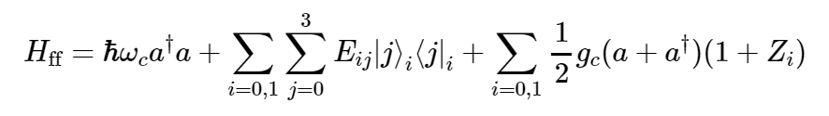
Hamiltonian
$$+\frac{1}{2}\sum_{i}{f_{i}\left(t\right)ω_{i} Z_{i}}$$
Cavity energy
Charge dipole
Relevant for 1Q Noise: Dephasing
Relevant for Cavity Coupling
Relevant for 2Q Noise: Relaxation
Not qualitatively relevant
Flip-flop energies
Charge-cavity coupling
$$Z_{ij}$$ | $$I$$ | $$τ_{x}$$ | $$τ_{y}$$ | $$τ_{z}$$
$$I$$ | $$0$$ | $$−\frac{Aω_{0}Δω_{B}\cos{η}\sin^{2}{η}}{4ω_{B}\left(ω_{0}^{2}−ω_{B}^{2}\right)}$$ | $$0$$ | $$\frac{A^{2}ω_{0}^{3}\cos{η}\sin^{2}{η}}{4ω_{B}{\left(ω_{0}^{2}−ω_{B}^{2}\right)}^{2}}$$
$$σ_{x}$$ | $$\sin{η}+\frac{A\cos{η}\sin{η}}{4ω_{0}}$$ | $$−\frac{Aω_{0}\cos{η}\sin{η}}{2\left(ω_{0}^{2}−ω_{B}^{2}\right)}$$ | $$0$$ | $$−\frac{Δω_{B}\cos{η}\sin{η}}{2ω_{0}}$$
$$σ_{y}$$ | $$0$$ | $$0$$ | $$−\frac{Aω_{0}\cos{η}\sin{η}}{2\left(ω_{0}^{2}−ω_{B}^{2}\right)}\frac{ω_{0}}{ω_{B}}$$ | $$0$$
$$σ_{z}$$ | $$\cos{η}−\frac{A\sin^{2}{η}}{4ω_{0}}$$ | $$\frac{Aω_{0}\sin^{2}{η}}{2\left(ω_{0}^{2}−ω_{B}^{2}\right)}$$ | $$0$$ | $$\frac{Δω_{B}\sin^{2}{η}}{2ω_{0}}$$
$$Z=\sum_{ij}{Z_{ij}σ_{i}τ_{j} }$$

Slide 10
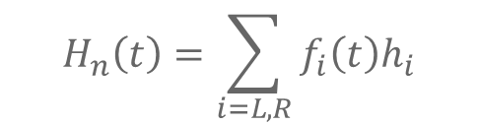
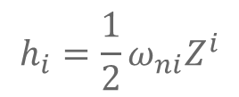
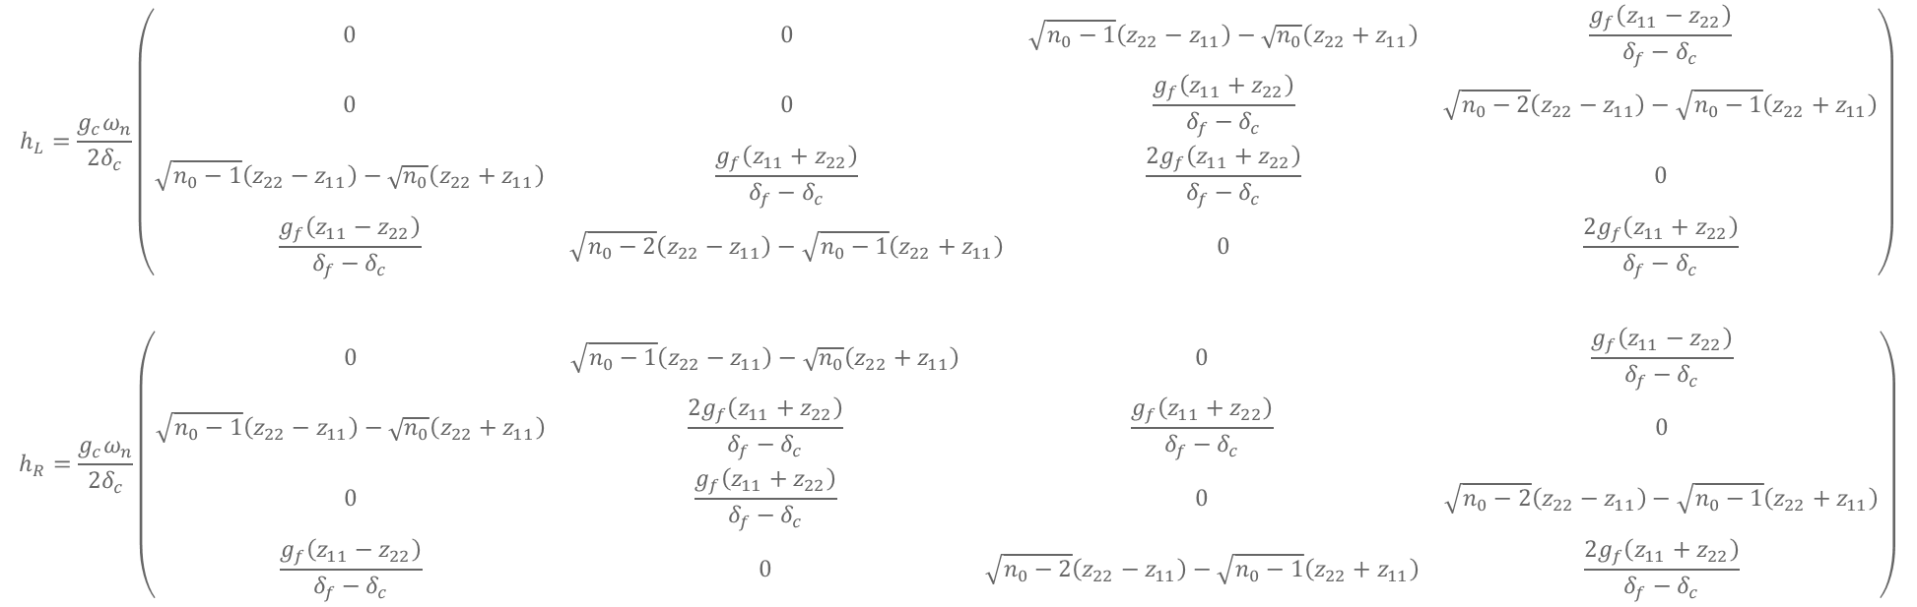
2nd Order SW Noise
$$H_{n}\left(t\right)=\sum_{i=L,R}{f_{i}\left(t\right)h_{i}}$$
$$h_{i}=\frac{1}{2}ω_{ni}Z^{i}$$
$$\left|n_{0}−0\right\rangle \left|00\right\rangle \\ \left|n_{0}−1\right\rangle \left|01\right\rangle \\ \left|n_{0}−1\right\rangle |10⟩$$
$$\left|n_{0}−2\right\rangle |11⟩$$
$$h_{L}=\frac{g_{c}ω_{n}}{{2δ}_{c}}\left(\begin{matrix}0 & 0 & \sqrt{n_{0}−1}\left(z_{22}−z_{11}\right)−\sqrt{n_{0}}\left(z_{22}+z_{11}\right) & \frac{g_{f}\left(z_{11}−z_{22}\right)}{δ_{f}−δ_{c}} \\ 0 & 0 & \frac{g_{f}\left(z_{11}+z_{22}\right)}{δ_{f}−δ_{c}} & \sqrt{n_{0}−2}\left(z_{22}−z_{11}\right)−\sqrt{n_{0}−1}\left(z_{22}+z_{11}\right) \\ \sqrt{n_{0}−1}\left(z_{22}−z_{11}\right)−\sqrt{n_{0}}\left(z_{22}+z_{11}\right) & \frac{g_{f}\left(z_{11}+z_{22}\right)}{δ_{f}−δ_{c}} & \frac{2g_{f}\left(z_{11}+z_{22}\right)}{δ_{f}−δ_{c}} & 0 \\ \frac{g_{f}\left(z_{11}−z_{22}\right)}{δ_{f}−δ_{c}} & \sqrt{n_{0}−2}\left(z_{22}−z_{11}\right)−\sqrt{n_{0}−1}\left(z_{22}+z_{11}\right) & 0 & \frac{2g_{f}\left(z_{11}+z_{22}\right)}{δ_{f}−δ_{c}}\end{matrix}\right)$$
$$h_{R}=\frac{g_{c}ω_{n}}{{2δ}_{c}}\left(\begin{matrix}0 & \sqrt{n_{0}−1}\left(z_{22}−z_{11}\right)−\sqrt{n_{0}}\left(z_{22}+z_{11}\right) & 0 & \frac{g_{f}\left(z_{11}−z_{22}\right)}{δ_{f}−δ_{c}} \\ \sqrt{n_{0}−1}\left(z_{22}−z_{11}\right)−\sqrt{n_{0}}\left(z_{22}+z_{11}\right) & \frac{2g_{f}\left(z_{11}+z_{22}\right)}{δ_{f}−δ_{c}} & \frac{g_{f}\left(z_{11}+z_{22}\right)}{δ_{f}−δ_{c}} & 0 \\ 0 & \frac{g_{f}\left(z_{11}+z_{22}\right)}{δ_{f}−δ_{c}} & 0 & \sqrt{n_{0}−2}\left(z_{22}−z_{11}\right)−\sqrt{n_{0}−1}\left(z_{22}+z_{11}\right) \\ \frac{g_{f}\left(z_{11}−z_{22}\right)}{δ_{f}−δ_{c}} & 0 & \sqrt{n_{0}−2}\left(z_{22}−z_{11}\right)−\sqrt{n_{0}−1}\left(z_{22}+z_{11}\right) & \frac{2g_{f}\left(z_{11}+z_{22}\right)}{δ_{f}−δ_{c}}\end{matrix}\right)$$

